Slide 1
DEVELOP AN OUTCOME L2
Evidence of Learning Template
0135221170
Brian Time Discord Bot
Brian Mao

Slide 2
https://drive.google.com/file/d/1Nr5fuEtxgypru-AT9RNO0maRa5yTcdWL/view?usp=sharing
https://trello.com/b/hjJ5s59j
You MUST provide evidence showing how the problem has been decomposed, how the components have been developed and trialled, and of how they have been assembled and tested to create a final, working outcome.

Slide 3
Project management: Setup
Record evidence that you have setup project management tools to manage the development of your outcome.
Record evidence that you have chosen project management techniques to manage the development of your outcome.
Record evidence that you have setup/ chosen version control tools/techniques to manage the development of your outcome.
Explain why you believe that these tools and techniques are appropriate for the development of your outcome.

Slide 4
Record evidence that you have setup project management tools to manage the development of your outcome
For the project management tool of the python program I could use monday.com or trello. From these two options trello had a simpler UI with tags representing tasks which you can drag between different boxes that can represent the state in which the task is whereas monday.com had checkboxes with due dates and a timeline. Monday.com also advertised itself as a group project management tool and I didnt think that i would work with other people on this project so i picked. In the event that i had to work on the outcome with a team i would have used monday.com, but since i was on my one i decided to use trello since it was a really basic project management tool.

Slide 5
Record evidence that you have chosen project management techniques to manage the development of your outcome.
On the next slide there are multiple screenshots of trello showing that i have moved tasks between states. It also shows that i have added more tasks on when i thought i had to do more things to further develop my outcome.

Slide 6
Decomposing outcome
Record evidence that you have broken the outcome into smaller components.
8ball
Cg
help
Lelouch
Ping
Save
weather

Slide 7
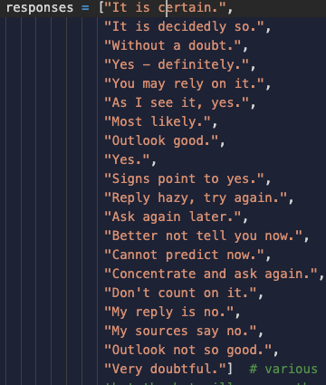

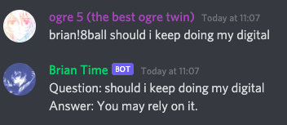
8ball
One of the seven commands my outcome can do. The user has to input a question and the bot will reply with 19 pre written responses. To do this i made a list with the responses and after using the command it will pick a random response to give. It will also send the question sent by the user incase the user forgot the question it asked the bot

Slide 8
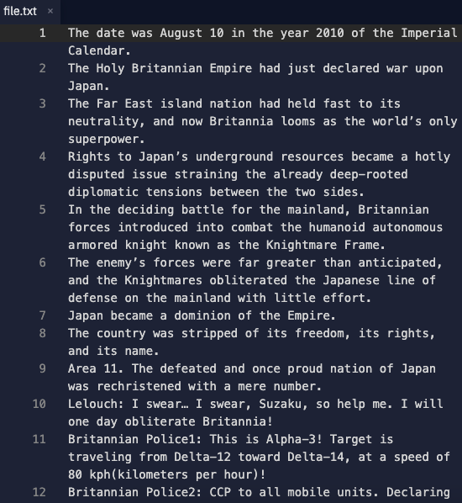

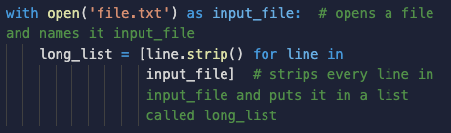

cg
Sends a random code geass quote from a text file. To do this i made a text document with every code geass quote with each quote on a new line. I then used some code to turn the text document into a list. Then using the random module i could make it choose a random quote to send.

Slide 9
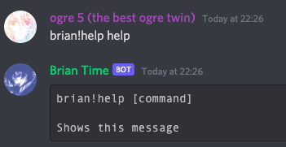
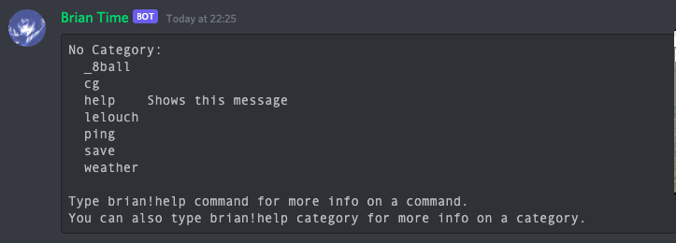
help
Sends all commands the outcomes does. Also able to send syntax needed to use other commands.

Slide 10
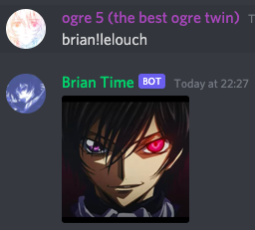
lelouch
Sends lelouch128.png.

Slide 11
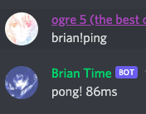
ping
Shows the latency of the discord bot in milliseconds. This is useful to know because it is a measure of how fast the bot is.

Slide 12
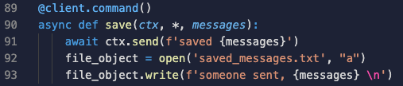
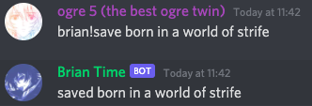

save
Saves a message into a text document. To do this i opened a file and used the ‘a’ppend mode to make it so add on to the existing saved_messages.txt file

Slide 13
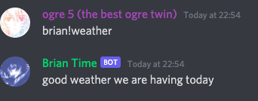
weather
Sends “good weather we are having today”

Slide 14
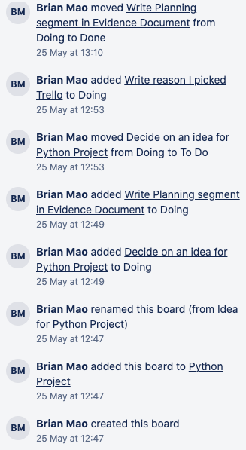
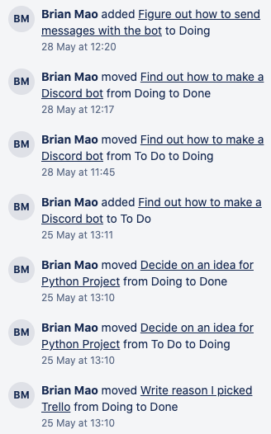
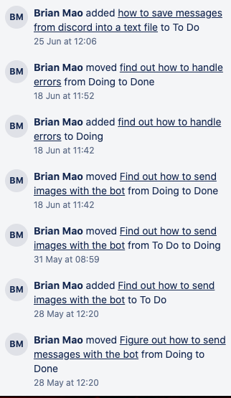

Decomposing outcome
Record evidence that you have broken the outcome into smaller components.

Slide 15
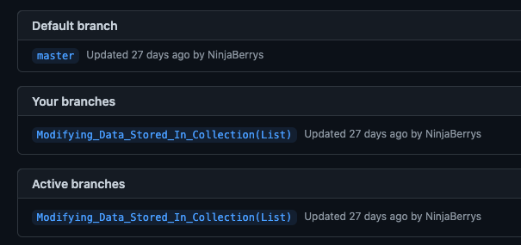
Record evidence that you have setup/ chosen version control tools/techniques to manage the development of your outcome.
I used the PyCharm version control feature because it was built into PyCharm which was the IDE i was using to code my outcome. I also connected my github so that after i leave school i would be able to look at my projects

Slide 16
Explain why you believe that these tools and techniques are appropriate for the development of your outcome.
I thought that trello was appropriate for the development of of my outcome because the lack of any advanced features made me focus on using the basic features. It also had a feature where it saved the history of changes to the board therefore making it easier to archive what was happening.

Slide 17
Trialling components
Record evidence that you have trialled components. Show that you gathered information to inform your decision making.
Record evidence that you have trialled multiple components and have selected those most suitable.
Record evidence that you have used information from trialling appropriately to improve the functionality of the outcome.

Slide 18

Record evidence that you have trialled components. Show that you gathered information to inform your decision making.
I trialled the message saving component multiple times to change the way it saves messages into the text file. At first I intended for the component to save the time in which the component was activated, but after careful consideration and not being able to it, I decided to not implement it. This was because this would have allowed me to be able to monitor the behavior of users of the bot. I could have sold this information to the authorities.

Slide 19
Testing outcome
Record evidence that you have tested your outcome.
Explain how the testing made sure your outcome functions as intended to meet its purpose and requirements.
Record evidence that you have used information from testing appropriately to improve the functionality of the outcome.

Slide 20

Self testing

Slide 21
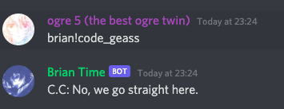
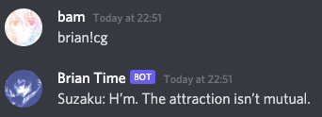
Stakeholder feedback
Getting your stakeholders involved to give you feedback is a useful way to know what it is that they want and maybe locate some issues would not have arisen if the stakeholders did not take a look. I showed my discord bot to Liam Blackford a fellow mags student and he said that the brian!cg command did not explain enough what the command did thats why i changed the command name to brian!code_geass

Slide 22
Debugging
After finishing the bot i debugged my code. This was useful as it helps me destroy all the errors and mistakes i created. It would be good for the end users to use the bot without the bot malfunctioning.

Slide 23
pep8
I used the pycharm “show context actions”. These actions are very powerful and are able to change the .py file into one that fits the pep8 guidelines. These guidelines are important because they make it so that multiple python developers can read code

Slide 24
Project management: Applied
Record evidence that you have used your project management tools to manage the development of your outcome.
Record evidence that you have used your project management techniques to manage the development of your outcome.
Record evidence that you have used version control tools to manage the development of your outcome.

Slide 25
Relevant Implications
Explain the relevant implications here. Please watch this video to learn how to do this.
Explain the Implications that are relevant to your outcome.
Record evidence that you have addressed the Implications that are relevant to your outcome.

Slide 26
Privacy Implications
The bot does not save any data specifically about the end users and is only able to save the text from the save command into a text document. I am the only one who has access to the document. The users also know that the bot will save the text used with the command so it is transparent

